Slide 1
Course Code: CSC4226
Course Title: Artificial Intelligence and Expert System
Dept. of Computer Science
Faculty of Science and Technology
Lecture No: | Two (2) | Week No: | Two (2) | Semester:
Lecturer: | Dr. Muhammad Firoz Mridha, Associate Professor, Dept. of CS Firoz.mridha@aiub.edu

Slide 2
Lecture Outline
Agents and Environments
Good Behavior: The Concept of Rationality
The Nature of Environments
The Structure of Agents

Slide 3
INTELLIGENT AGENT
Agent: entity in a program or environment capable of generating action.
An agent uses perception of the environment to make decisions about actions to take.
The perception capability is usually called a sensor.
The actions can depend on the most recent perception or on the entire history (percept sequence).

Slide 4
AGENT V/S PROGRAM
Size - an agent is usually smaller than a program.
Purpose - an agent has a specific purpose while programs are multi-functional.
Persistence - an agent's life span is not entirely dependent on a user launching and quitting it.
Autonomy - an agent doesn't need the user's input to function.

Slide 5
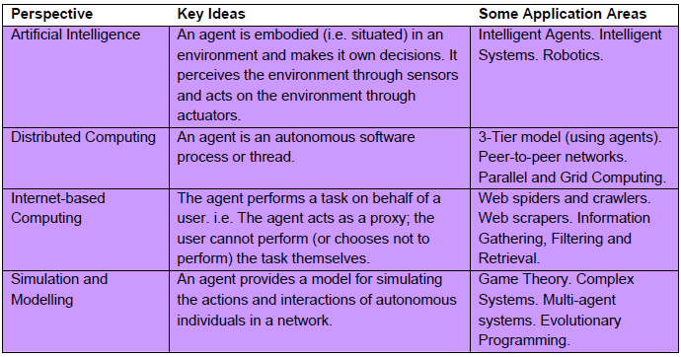
WHAT IS AN AGENT ?

Slide 6
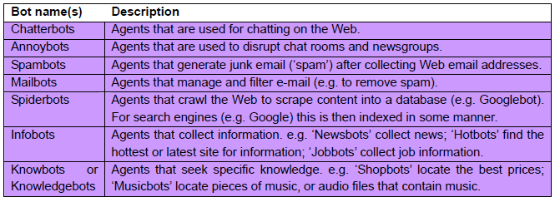
ROBOTS AND THEIR APPLICATION

Slide 7
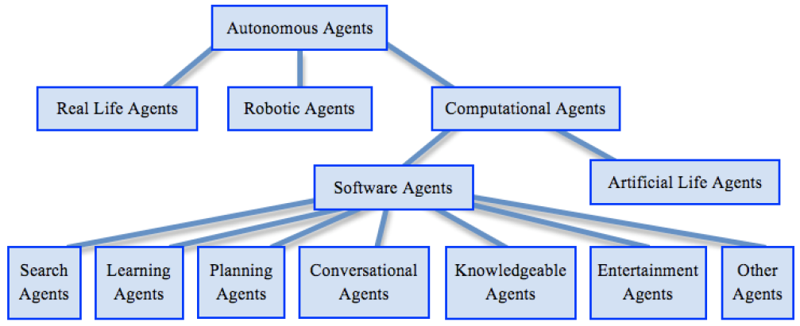
TAXONOMY OF AUTONOMOUS AGENT

Slide 8
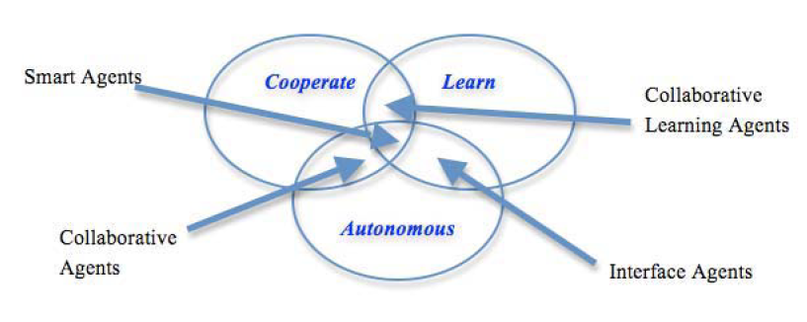
AGENT TOPOLOGY

Slide 9
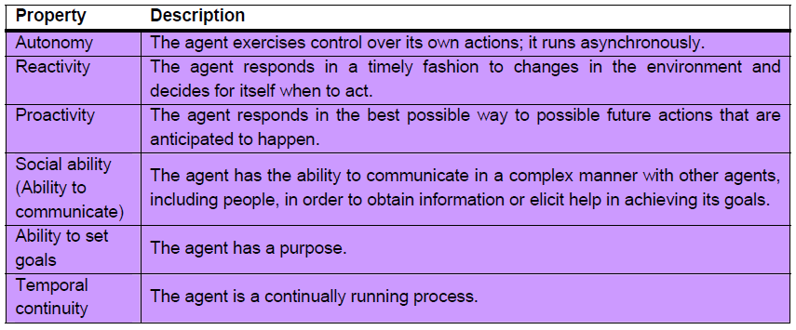
DESIRABLE PROPERTIES OF AGENT

Slide 10
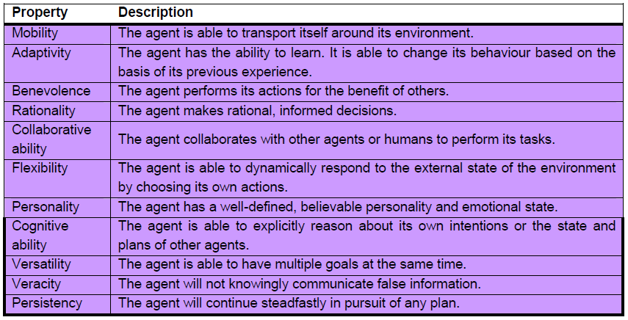
DESIRABLE PROPERTIES OF AGENT
Continued..

Slide 11
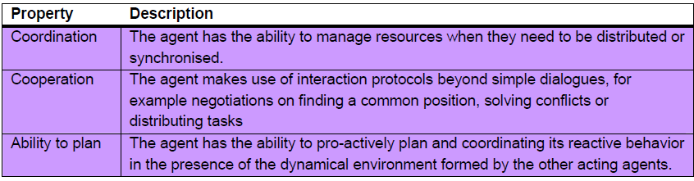
DESIRABLE PROPERTIES OF AGENT
Continued..

Slide 12
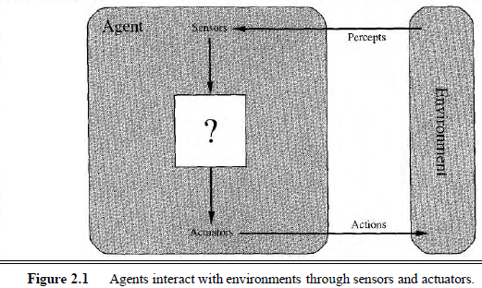
AGENT AND ENVIRONMENT
ENVIRONMENT
SENSOR
ACTUATORS
PERCEPT
PERCEPT SEQUENCE
AGENT FUNCTION
AGENT PROGRAM

Slide 13
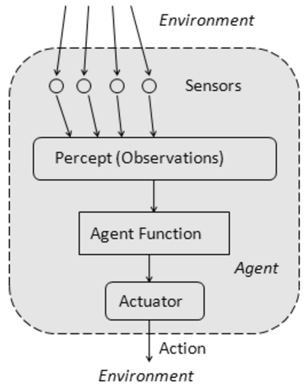
AGENT FUNCTION
The agent function is a mathematical function that maps a sequence of perceptions into action.
The function is implemented as the agent program.
The part of the agent taking an action is called an actuator.
environment -> sensors -> agent function -> actuators -> environment

Slide 14
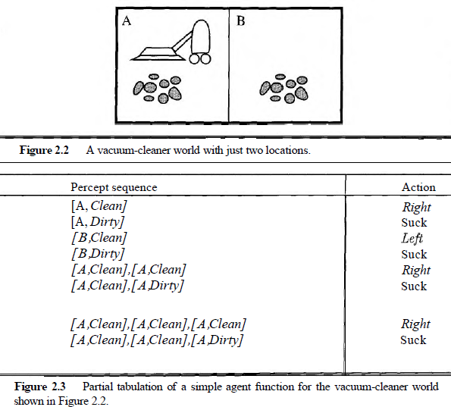
VACUUM CLEANING AGENT

Slide 15
GOOD BEHAVIOR: THE CONCEPT OF RATIONALITY
Rational Agent
- one does the right thing
- Every entry in the table for the agent function is filled out correctly
What does it mean to do the right thing ?
by considering the consequences of the agent's behavior
Agent - >plunked down in an environment
-> generates a sequence of actions
-> according to the percepts it receives.
sequence of actions -> causes
-> the environment
-> to go through a sequence of states.
If the sequence of states is desirable, then the agent has performed well.
performance Measure –
evaluates any given sequence of environment states

Slide 16
RATIONAL AGENT
A rational agent is one that can take the right decision in every situation.
Performance measure: a set of criteria/test bed for the success of the agent's behavior.
The performance measures should be based on the desired effect of the agent on the environment.

Slide 17
RATIONALITY
The agent's rational behavior depends on:
the performance measure that defines success
the agent's knowledge of the environment
the action that it is capable of performing
the current sequence of perceptions.
Definition: for every possible percept sequence, the agent is expected to take an action that will maximize its performance measure.

Slide 18
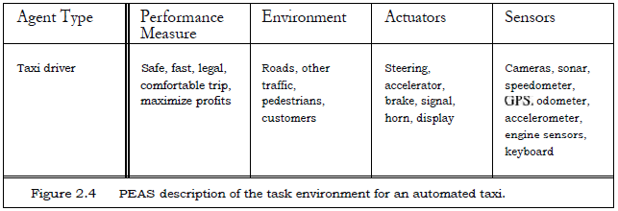
SPECIFYING THE TASK ENVIRONMENT: PEAS DESCRIPTION

Slide 19
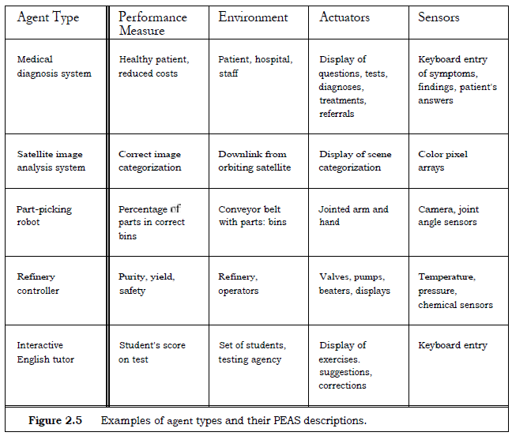
PEAS: Examples

Slide 20
PROPERTIES OF TASK ENVIRONMENT
Fully v/s Partially Observable
Unobservable
Single Agent v/s Multi Agent
Deterministic v/s Stochastic
Nondeterministic
Uncertain Environment
Episodic V/s Sequential
Static v/s Dynamic
Discrete v/s Continuous
Known v/s Unknown

Slide 21
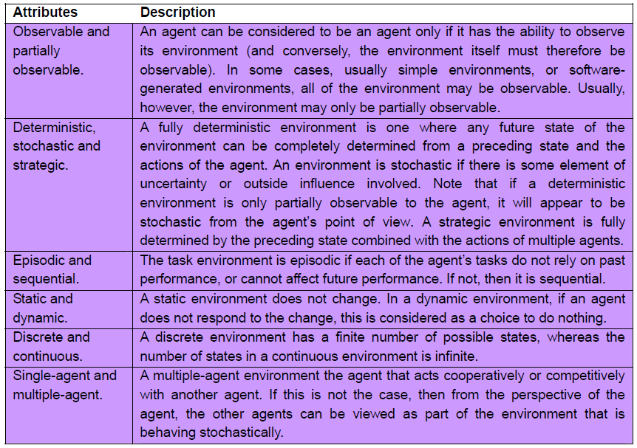
PROPERTIES OF TASK ENVIRONMENT

Slide 22
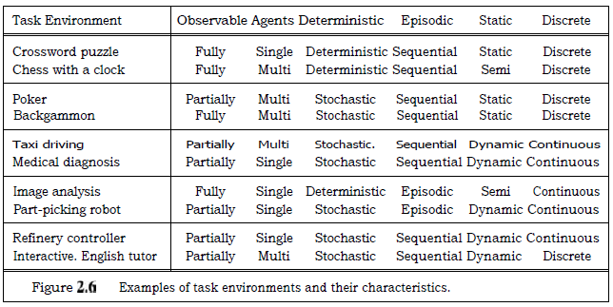
TASK ENVIRONMENT: EXAMPLES

Slide 23
THE STRUCTURE OF AGENTS
Architecture: computing device + physical sensors and actuators
architecture makes the percepts from the sensors available to the agent program,
runs the program,
and feeds the program's action choices to the actuators as they are generated.
Agent programs
take the current percept as input from the sensors and return an action to the actuators.

Slide 24
AGENT EXAMPLE: TABLE DRIVEN AGENT
Table-driven agents: the function consists in a lookup table of actions to be taken for every possible state of the environment.
If the environment has n variables, each with t possible states, then the table size is t^{n}.
Only works for a small number of possible states for the environment.
Simple reflex agents: deciding on the action to take based only on the current perception and not on the history of perceptions.
Based on the condition-action rule: (if (condition) action)
Works if the environment is fully observable

Slide 25
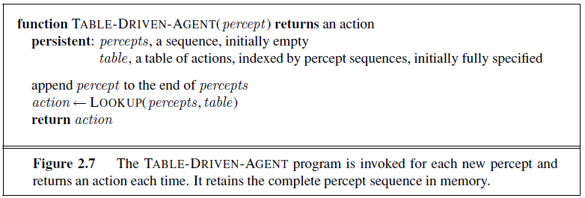
TABLE-DRIVEN-AGENT

Slide 26
VACUUM CLEANING AGENT: Table Driven

Slide 27
Table Drives
percepts = []
table = {}
def table_agent (percept):
action = True
percepts.append(percept)
action = lookup(percepts, table)
return action

Slide 28
LIMITATION OF TABLE-DRIVEN AGENT
no physical agent in this universe will have the space to store the table,
the designer would not have time to create the table,
no agent could ever learn all the right table entries from its experience, and
even if the environment is simple enough to yield a feasible table size, the designer still has no guidance about how to fill in the table entries

Slide 29
BASIC KINDS OF AGENT PROGRAMS
Simple reflex agents
Model-based reflex agents
Goal-based agents
Utility-based agents.

Slide 30
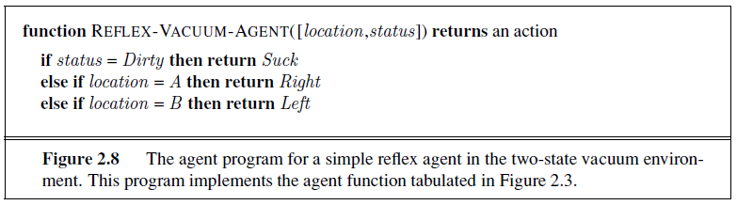
SIMPLE REFLEX AGENTS
select actions on the basis of the current percept, ignoring the rest of the percept history.
a condition-action rule, written as
if car-in-front-is-braking then initiate-braking.
general and flexible approach is first to build a
general-purpose interpreter for condition-action rules and
then to create rule sets for specific task environments.

Slide 31
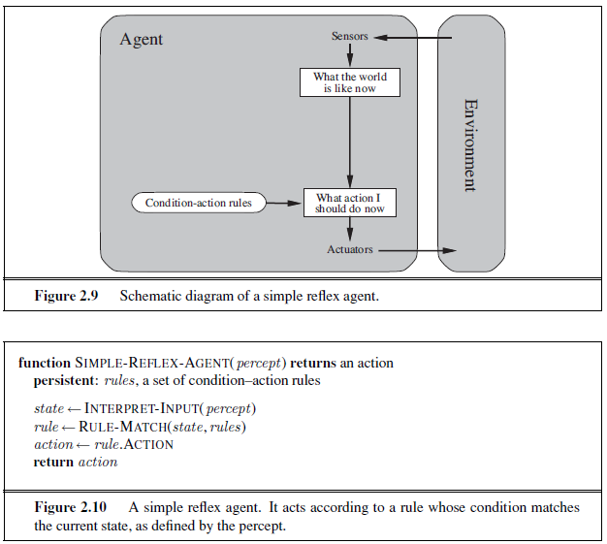
Background Information
used in the Process
Current internal state
of Decision Process
Only if the Environment is
Fully Observable
What will happen? when,
Vacuum Cleaner with poor perception!
Without location sensor !

Slide 32
MODEL-BASED REFLEX AGENTS
keep track of the part of the world it can't see now. [handle partial observability]
model of the world
That is, the agent should maintain some sort of internal state that depends on the percept history and thereby reflects at least some of the unobserved aspects of the current state.
Updating this internal state information as time goes by requires two kinds of knowledge to be encoded in the agent program.
First, we need some information about how the world evolves independently of the agent
[ex. overtaking car]
Second, we need some information about how the agent's own actions affect the world
[ex. Turn steering wheel clockwise..]
This knowledge about "how the world works"—whether implemented in simple Boolean circuits or in complete scientific theories - is called a model of the world.

Slide 33
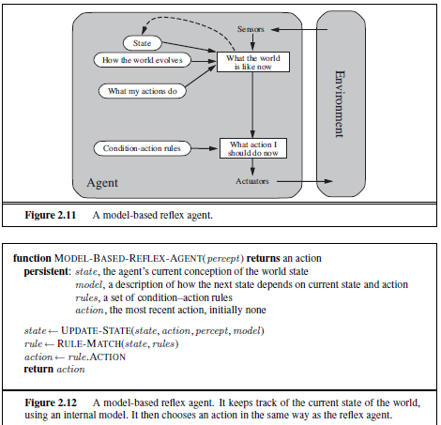

Slide 34
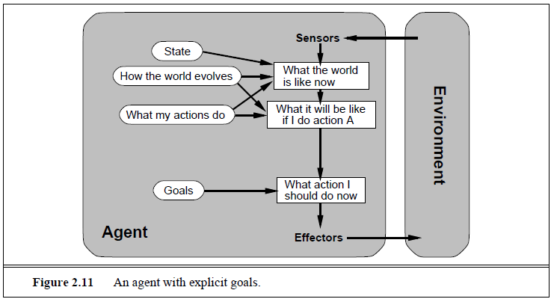
GOAL-BASED AGENT
Searching
Planning
decision making

Slide 35
UTILITY-BASED AGENTS
Goals alone are not enough to generate high-quality behavior in most environments.
An agent's utility function is essentially an internalization of the performance measure.
flexibility and learning
In two kinds of cases, goals are inadequate, but a utility-based agent can still make rational decisions
when there are conflicting goals, only some of which can be achieved
(for example, speed and safety), the utility function specifies the appropriate tradeoff.
2. when there are several goals that the agent can aim for, none of which can be achieved with certainty, utility provides a way in which the likelihood of success can be weighed against the importance of the goals.

Slide 36
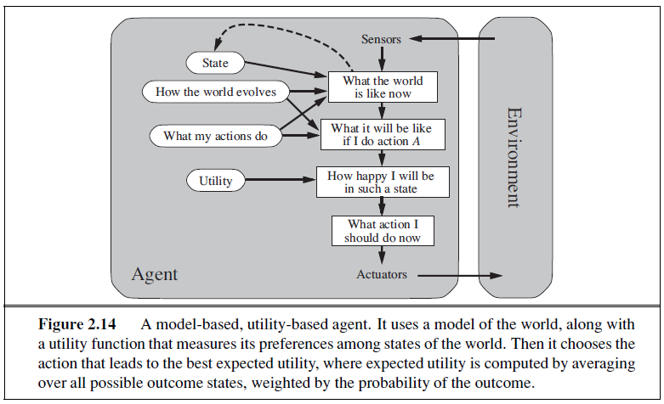

Slide 37
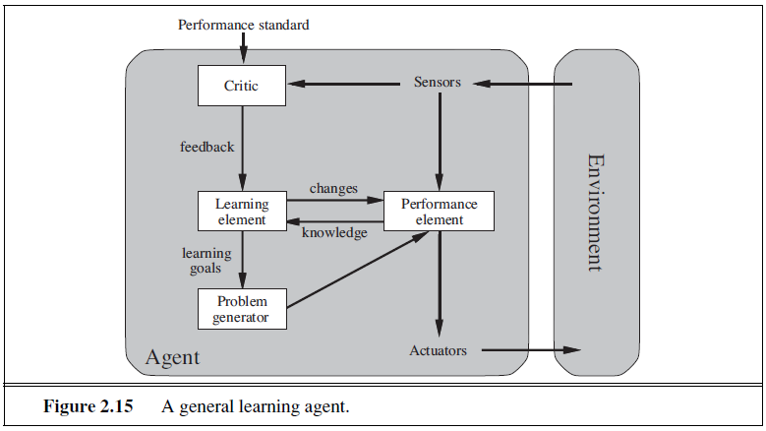
LEARNING AGENT

Slide 38
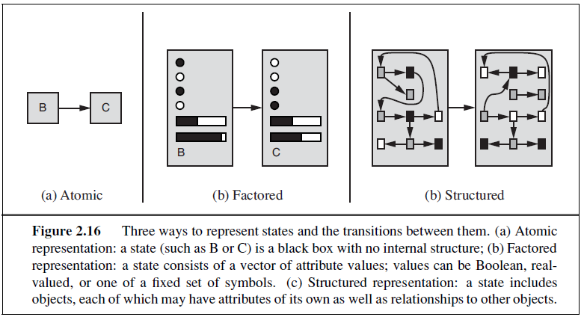
HOW COMPONENT OF AGENT PROGRAMS WORK

Slide 39
References
Chapter 2: Intelligent Agents , Pages 34-58
“Artificial Intelligence: A Modern Approach,” by Stuart J. Russell and Peter Norvig,

Slide 40
Books
“Artificial Intelligence: A Modern Approach,” by Stuart J. Russell and Peter Norvig.
"Artificial Intelligence: Structures and Strategies for Complex Problem Solving", by George F. Luger, (2002)
"Artificial Intelligence: Theory and Practice", by Thomas Dean.
"AI: A New Synthesis", by Nils J. Nilsson.
“Programming for machine learning,” by J. Ross Quinlan,
“Neural Computing Theory and Practice,” by Philip D. Wasserman, .
“Neural Network Design,” by Martin T. Hagan, Howard B. Demuth, Mark H. Beale, .
“Practical Genetic Algorithms,” by Randy L. Haupt and Sue Ellen Haupt.
“Genetic Algorithms in Search, optimization and Machine learning,” by David E. Goldberg.
"Computational Intelligence: A Logical Approach", by David Poole, Alan Mackworth, and Randy Goebel.
“Introduction to Turbo Prolog”, by Carl Townsend.

